Slide 1
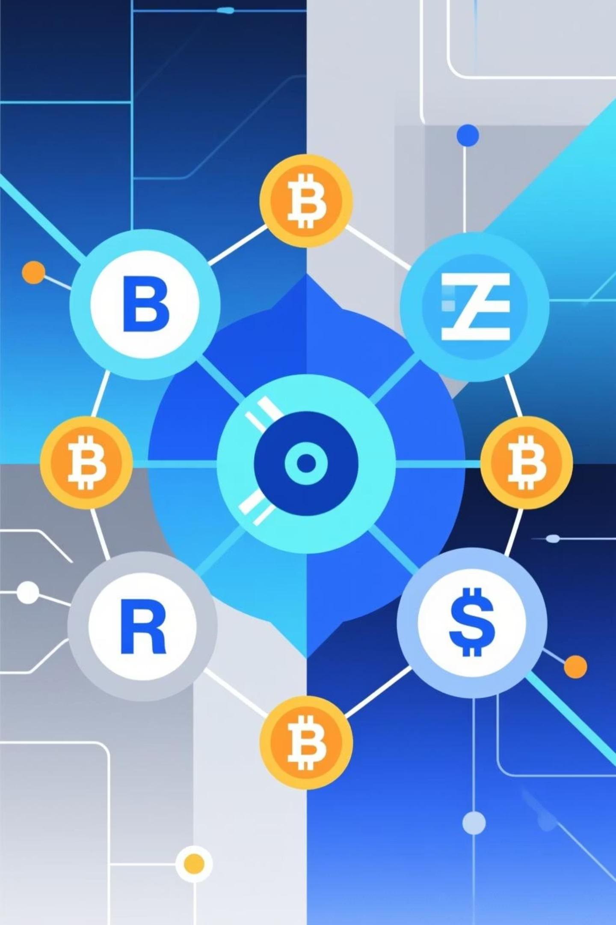

Polygon zkEVM: Proof Forgery Attack Case Study
A Case Study in Modern Cryptographic Security
Prepared for: Modern Cryptographic Methods (Lab CA-II)
Aaryan Sharma - 16010123012
Aditya Baheti - 16010123023
Amandeep Singh - 16010123036
Ambuj Rai - 16010123037
Anuj Madke - 16010123052

Slide 2
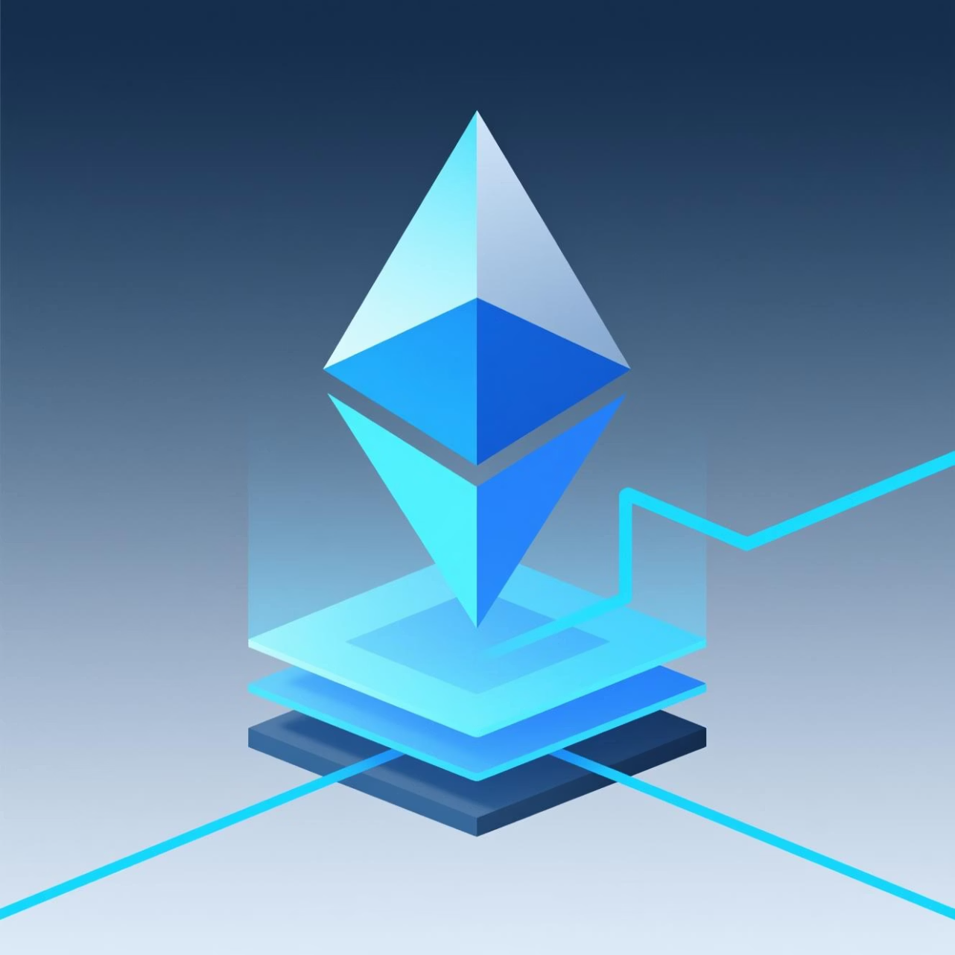
Introduction: What is Polygon zkEVM?
Ethereum Layer 2 Scaling Solution
Zero-Knowledge Proofs (ZKPs)
Utilises ZKPs to validate off-chain transaction batches, ensuring security while maintaining high throughput and significantly reduced fees.
The Importance of zkEVM
Aims to resolve Ethereum's chronic transaction speed and cost limitations (scalability trilemma) without compromising on security or full EVM compatibility.

Slide 3

Background: The Need for Layer 2 Solutions
Ethereum’s Challenge
Massive Demand
ZK-Rollup Solution
Base Layer throughput is limited to approximately 15 Transactions Per Second (TPS), leading to congestion and prohibitively high Gas fees.
The exponential growth of Decentralised Finance (DeFi) and GameFi requires a capacity increase far exceeding Layer 1 capabilities.
Layer 2 rollups (specifically ZK-Rollups) batch transactions off-chain and submit a single cryptographic proof to Ethereum.
Polygon zkEVM represents the first true EVM-compatible ZK-Rollup, allowing DApps to port their Solidity code seamlessly, a major technical feat.

Slide 4




Advanced Cryptographic Techniques in zkEVM
The security and efficiency of the zkEVM rely on cutting-edge cryptographic primitives.
Zero-Knowledge Proofs
Recursive Proofs
Specifically using zk-SNARKs (e.g., Groth16) to prove computational integrity without revealing input data.
Technique used to efficiently aggregate numerous small ZKPs into a single, compact master proof that is verified on L1.
Goldilocks Field Arithmetic
Polynomial Commitments
A 64-bit finite field specially selected for fast, secure cryptographic computations within the circuit environment.
Used to represent large data sets, such as the state of the system or execution traces, in a concise, verifiable way.

Slide 5
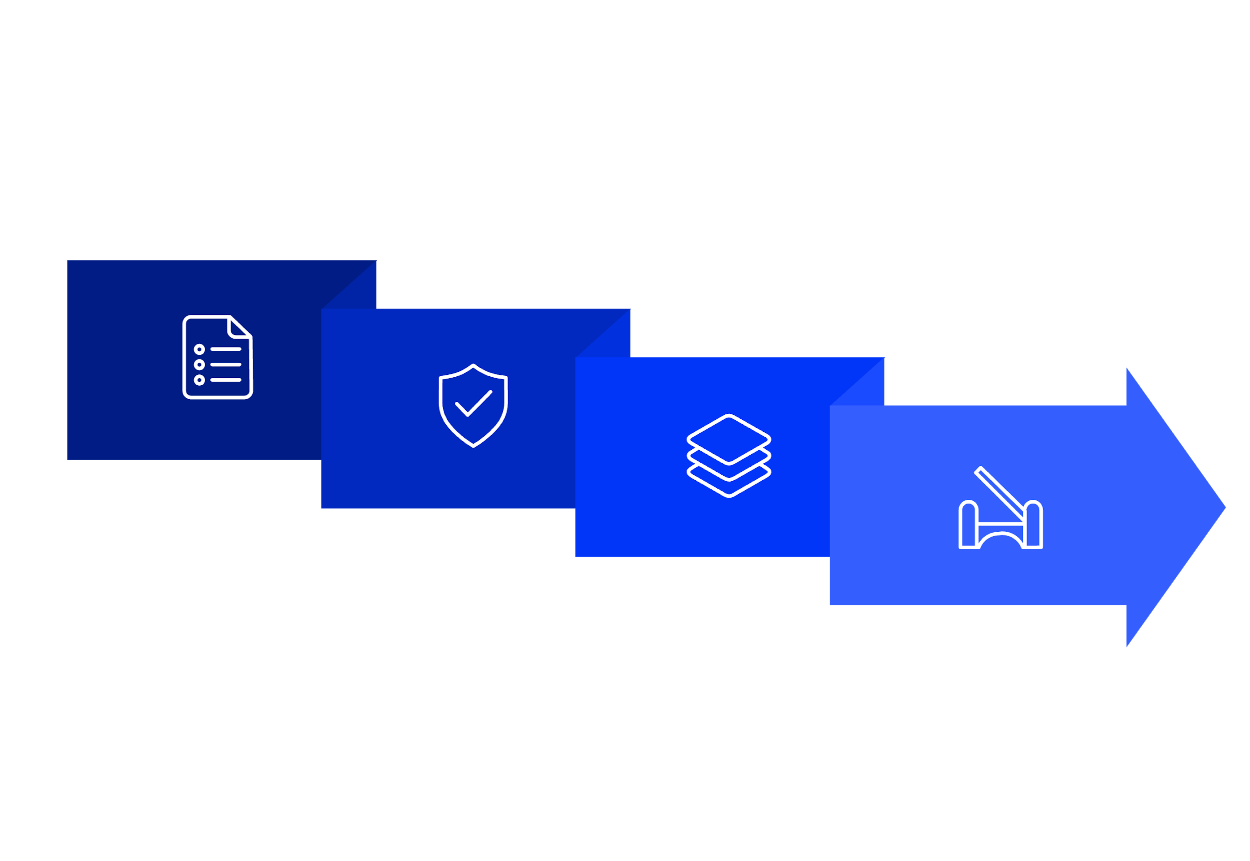
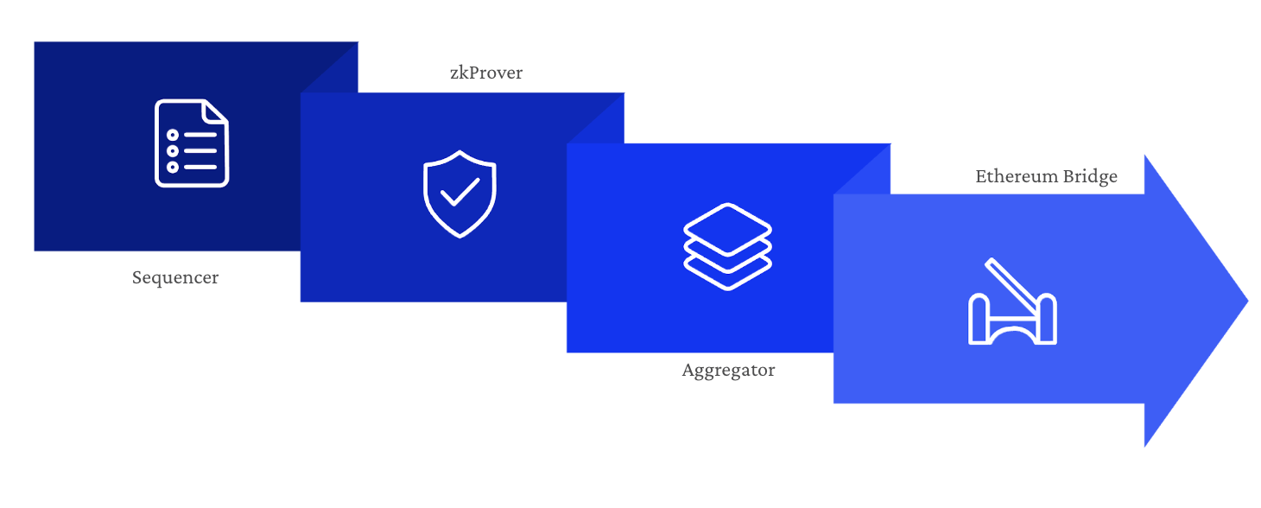




Polygon zkEVM System Architecture
The L2 system is divided into specialised, interconnected components handling the end-to-end transaction lifecycle.
zkProver
Ethereum Bridge
Sequencer
Aggregator
The core operational components are:
Sequencer: Gathers and orders L2 transactions into batches.
zkProver: The off-chain engine that generates the computationally heavy ZK proofs for transaction validity.
Aggregator: Bundles the state updates and the final ZK proof, submitting them to the Layer 1 contract.
Bridge: The smart contract layer connecting the L2 chain back to the main Ethereum network.

Slide 6

Mechanism of zk-SNARK Proof Verification
From Logic to Proof
The logic of L2 transactions (e.g., 'transfer 5 ETH') is represented as a complex mathematical circuit.
Prover: Executes the transaction and generates a succinct proof of correct execution. The proof reveals nothing about the private inputs.
Verifier: A small, efficient smart contract on Ethereum (L1) verifies the proof against the public inputs. This validation ensures that the L2 state transition was performed correctly and honestly.
The use of a trusted setup (for Groth16) is necessary to generate the public parameters needed for proof generation and verification.

Slide 7
The Critical Vulnerabilities Discovered
In 2023, independent security researchers (Verichains and Spearbit) discovered severe flaws in the zkEVM implementation.
Arithmetic Faults
Insufficient Checks
Forging Capability
A critical flaw was found in the implementation of Goldilocks Field arithmetic, specifically relating to how multiplication and addition operations were handled.
The circuit implementation failed to include essential checks to prevent numeric overflows within the Goldilocks field.
This flaw permitted a malicious aggregator to craft a mathematically 'valid' ZK proof for any arbitrary, invalid state change.
Undetectable proof forgery meant an attacker could potentially steal user funds or corrupt the entire Layer 2 state without immediate detection by the L1 verifier.

Slide 8

Details: Goldilocks Field Overflow
The vulnerability stems from the core mathematical operations essential to the zero-knowledge circuit.
The Unsafe Operation
Valid Field Element
0 to p-1
The Goldilocks Field is a 64-bit finite field defined by a large prime modulus (p \approx 2^{64}). All mathematical results must remain within this field's range.
Forged Field Element
Value > p (Overflow)
When an attacker induced an overflow, the invalid transaction data was mapped back into the valid field range in a way that satisfied the circuit constraints, essentially lying to the proof system.
The flawed code for arithmetic operations, such as multiplication, did not correctly enforce the bounds, allowing an element to exceed the field size.
This incident underscores a critical lesson: errors in low-level cryptographic arithmetic can completely compromise the security guarantees of an entire blockchain system.

Slide 9

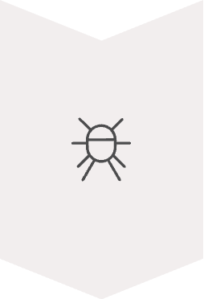


Proof of Concept Attack Scenario
An attacker could leverage the Goldilocks field vulnerability to execute a catastrophic, malicious state change.
Craft Invalid State
Attacker creates a transaction that arbitrarily sets the Layer 2 state (e.g., giving themselves all L2 assets) or submits an invalid withdrawal request.
Forge ZK Proof
The attacker exploits the overflow bug to craft a cryptographic ZK proof that successfully passes verification, despite being based on the fraudulent state transition.
Submission and Acceptance
The forged proof is submitted by the aggregator to the Ethereum Bridge contract.
Arbitrary State Change
Since the proof is mathematically sound to the verifier, the L1 contract accepts the malicious state, allowing the attacker to drain all assets or corrupt the L2 chain.
Notes:
This slide outlines the proof-of-concept attack scenario. An attacker could leverage the Goldilocks field vulnerability to execute a catastrophic, malicious state change.
It would happen in these steps:
First, they Craft an Invalid State. The attacker creates a transaction that arbitrarily sets the Layer 2 state. For example, giving themselves all L2 assets or submitting a fake withdrawal request.
Next, they Forge the ZK Proof. This is the core of the attack. The attacker exploits the overflow bug to craft a cryptographic ZK proof. This proof successfully passes verification, even though it's based on a completely fraudulent state transition.
Then, comes Submission and Acceptance. The forged proof is submitted by the aggregator to the Ethereum Bridge contract.
The result is an Arbitrary State Change. Because the proof appears mathematically sound to the verifier, the L1 contract accepts the malicious state. This would allow the attacker to drain all assets or corrupt the entire L2 chain."

Slide 10



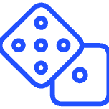

Critical Security Flaws in ZK Implementations
A comprehensive security audit revealed over 10 severe vulnerabilities, highlighting the inherent complexity and risk in deploying zero-knowledge solutions.
Commitment Flaws
Bridge Contract Logic Bugs
Issues in the cryptographic commitment schemes that could lead to proof manipulation or forgery.
Critical errors in the inter-chain bridge logic, potentially allowing unauthorized fund withdrawals or asset freezing.
Reentrancy and Overflows
Insufficient Randomisation
Traditional smart contract vulnerabilities like reentrancy attacks and integer overflow/underflow risks within key components.
Lack of robust randomisation in the Prover component, weakening the security of the proof generation process.
The severity of these findings underscores the importance of exhaustive, multi-layer audits before any mainnet deployment.
Notes:
"The Goldilocks bug was severe, but it wasn't the only issue. A comprehensive security audit revealed over 10 severe vulnerabilities. This really highlights the inherent complexity and risk in deploying zero-knowledge solutions.
Other major flaws included:
Commitment Flaws: There were issues in the cryptographic commitment schemes that could lead to proof manipulation or forgery.
Bridge Contract Logic Bugs: These were critical errors in the bridge logic, which could potentially allow unauthorized fund withdrawals or asset freezing.
Reentrancy and Overflows: The audit also found traditional smart contract vulnerabilities, like reentrancy attacks and integer overflow/underflow risks, within key components.
And Insufficient Randomisation: A lack of robust randomization in the Prover component was found, which weakens the security of the proof generation process.
These findings showed that even with top-tier cryptography, implementing it securely in a blockchain system is extremely complex.

Slide 11

Security Response and Remediation Timeline
September 2023
1
Vulnerability Discovery:
Initial identification of critical flaws through internal reviews and early audit processes.
2
September–January
Extended Audits:
Over four months of rigorous analysis by independent security teams, including Spearbit, to ensure comprehensive coverage.
Immediate Implementation
3
Technical Fixes:
Implementation of fixes including strict input validation, utilising 128-bit arithmetic for critical calculations, and deploying formal verification techniques.
4
Post-Remediation
Staged Rollout:
A careful, staged mainnet rollout ensured that the system was secured without any loss of user funds.
Notes:
The Polygon team responded immediately.
The vulnerabilities were first reported in September 2023, and within days, internal patches were underway.
They implemented strict input validation, switched to 128-bit arithmetic, and introduced formal verification — a mathematical process to ensure that every constraint behaves correctly.
Over the next four months, independent security teams, including Spearbit, audited all fixes thoroughly.
The final rollout was staged carefully to ensure no disruption, and most importantly — no user funds were lost.
Finally, my frnd will share the broader lessons this incident taught the blockchain community.

Slide 12



Broader Impact and Key Lessons Learned
The incident served as a wake-up call, redefining security best practices for all Layer 2 and ZK ecosystems.
Formal Verification
Highlighting Complexity
Decentralisation Imperative
Mandated the use of mathematical proofs to ensure the correctness of cryptographic constraints and smart contract logic.
Exposed the immense complexity and potential attack surface within production-ready ZK-Rollup implementations.
Emphasised the danger of relying on centralised aggregators, driving the push towards more decentralised security models.
This security event directly led to the establishment of industry-wide standards for Layer 2 security auditing and disclosure protocols.

Slide 13
Key Statistics and Remediation Metrics
The scale of the threat and the scope of the response effort were significant, demanding extensive resource allocation.
14
$500M+
3+
35
Severe Vulnerabilities
Potential Risk
Months to Remediate
System Components
Total number of high-risk flaws discovered across the ZK system components.
Estimated value of assets potentially jeopardised had the vulnerabilities been exploited.
Time required for the full identification, fixing, re-auditing, and safe deployment of all patches.
Number of distinct cryptographic and smart contract modules rigorously tested during the comprehensive audit.
Transparency and rapid disclosure were essential in maintaining user confidence and ensuring the long-term integrity of the platform.

Slide 14
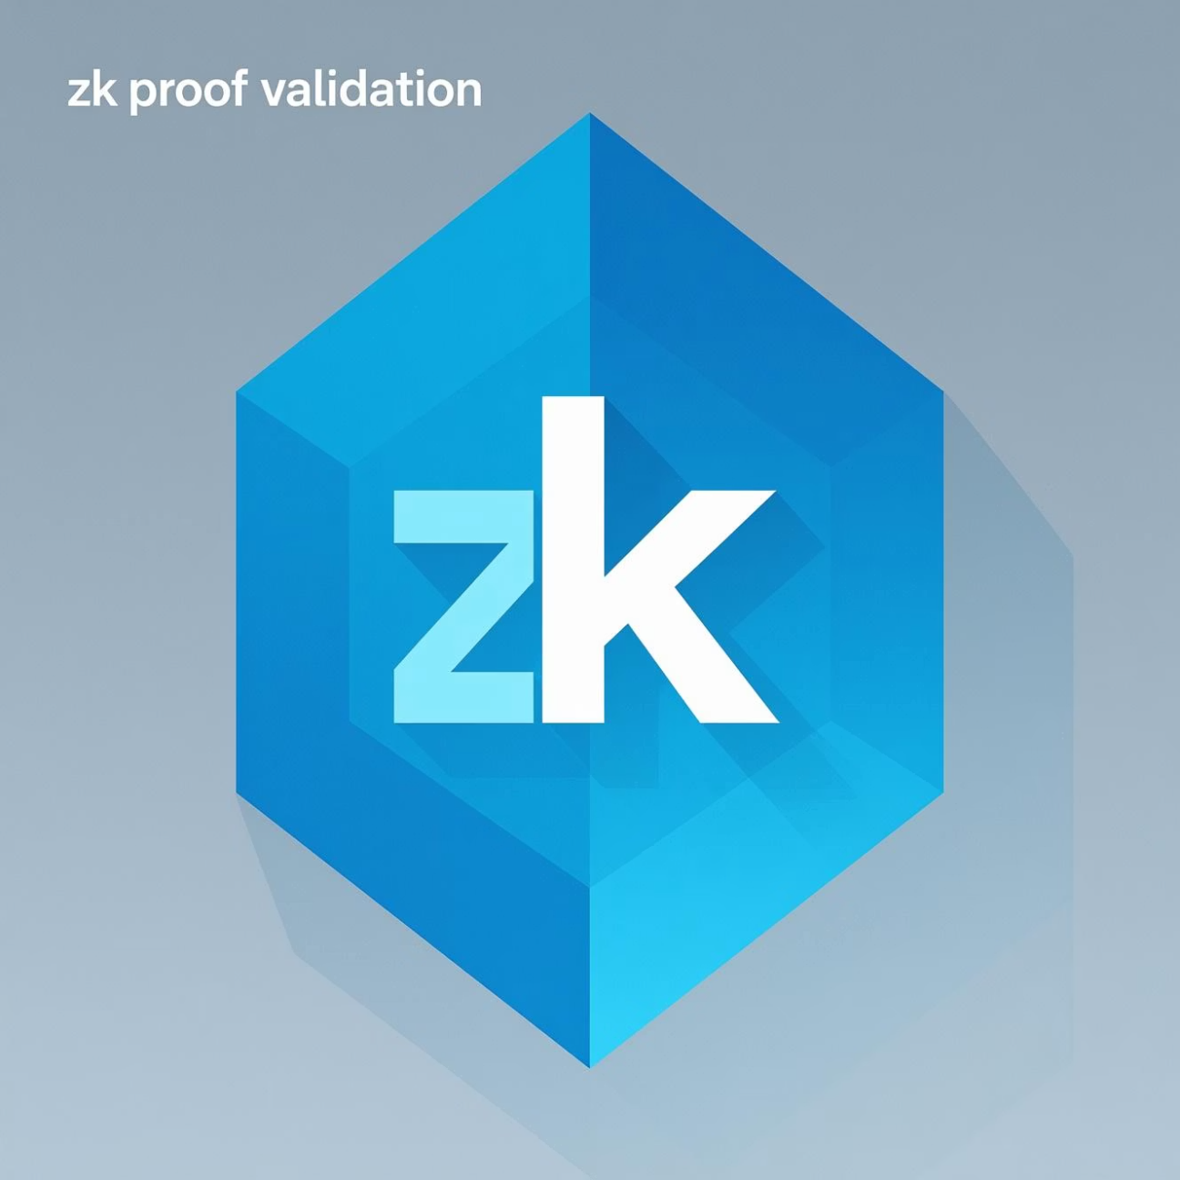
Summary: The Need for Rigorous Engineering
The Proof Forgery Bug
The Polygon zkEVM vulnerability represented one of the most severe proof forgery bugs ever identified on a live blockchain infrastructure.
It demonstrated that even advanced cryptographic systems are susceptible to complex implementation errors.
The flaw had the potential to compromise the integrity of the entire rollup state.
The incident set a new benchmark for the scrutiny required in deploying zero-knowledge technology.
This event fundamentally reinforced the critical need for rigorous cryptographic engineering, continuous auditing, and transparent governance for all ZK-based blockchain projects.

Slide 15
Reference Material
Verichains Blog
Polygon Official Disclosure
Technical deep-dive into the Polygon zkEVM Vulnerability and exploit vectors.
Official statements, audit results, and remediation processes published by the development team.
Spearbit Security Report
Groth16 zkSNARKs Paper
Detailed findings and recommendations from the primary independent security audit team.
The foundational cryptographic research paper relevant to the zero-knowledge proof scheme used.

Slide 16

Thank You

